Slide 1
Refraction
CHAPTER 10 :Part 3
Notes:
Hi students. In this chapter, we are going to learn all about reflection and refraction of light.

Slide 2

Refraction of Light
Notes:
Let us look at the next concept called Refraction of light.
Now what is refraction?
The phenomenon due to which a a ray of light deviates from its original path while travelling from one optical medium to another optical medium. This is called refraction.
The cause of refraction of light is the change in the speed of light when it passes from one optical medium to another.

Slide 3
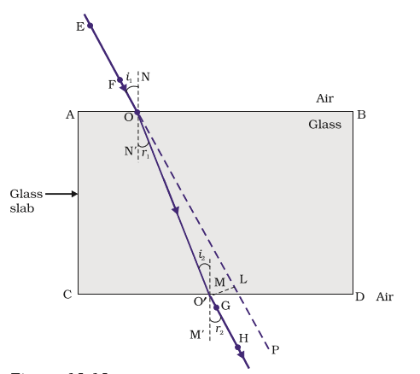
Refraction through a Rectangular Glass Slab
Notes:
In this diagram we see a ray passing through a glass slab which is a denser medium.
Ray EO is the incident ray.
The point O is called the point of incidence. The perpendicular drawn at the point of incidence is called normal
The ray of light which deviates from its path from entering the other optical medium(glass slab) is called the refracted ray.(OO’)
The angle which the refracted ray makes with the normal is called the angle of refraction.(r₁)
The direction in which the ray light bends depends on the medium through which it is travelling initially. When a ray of light travels from a rarer medium to a denser medium(air to glass) obliquely, it always bends towards the normal drawn at the point of incidence.
In this case the angle of incidence is always greater than the angle of refraction.
When a ray of light travels from an optically denser to a rarer medium obliquely, the ray bends away from the normal.
When the ray passes from the glass slab to air, O’H bends away from the normal at surface CD.This ray is called the emergent ray.The angle made between the normal at point O’ and the emergent ray is called the angle of emergence(r₂).
The perpendicular distance between the incident ray produced and the emergent ray is called lateral displacement (O’L).
.

Slide 4
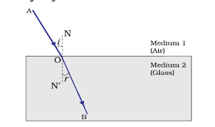
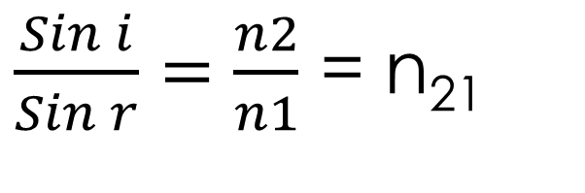
Laws of Refraction of Light
$\frac{Sin i}{Sin r}=\frac{n2}{n1}$ = n₂₁
Notes:
Moving on to the laws of refraction.
According to experiments it is seen that a slant ray of light passing through a glass slab bends at the interface of the two medium.This results in the laws of refraction.
The incident ray, refracted ray and the normal at the point of incidence O all lie in the same plane.
The ratio of the sine of the angle of incidence to the sine of the angle of refraction is a constant for a given pair of optical media. This constant is called refractive index(n21).
Note: when a ray travels from one optical medium to another at right angles(90 degrees) to the surface,it suffers no refraction.

Slide 5

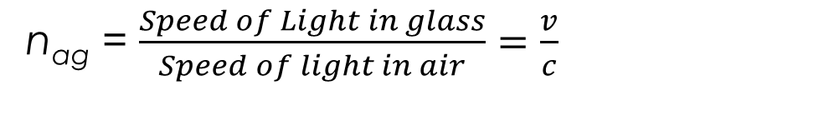
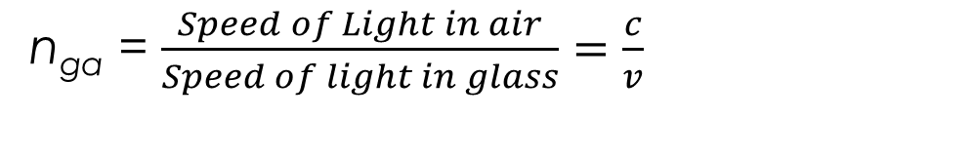
Refractive index
The refractive index of glass with respect to air is given by ratio of speed of light in air to the speed of light in glass.
Refractive index of air with respect to glass is given by
n_{ga} = $\frac{Speed of Light in air}{Speed of light in glass}=\frac{c}{v}$
n_{ag} = $\frac{Speed of Light in glass}{Speed of light in air}=\frac{v}{c}$
Notes:
Given above is the refractive index in terms of speeds of light in each medium.
Refractive index of water is said to be1.33.
Refractive index of glass is said to be 1.52
Refractive index of glass wrt air is given by Speed of light in air to the speed off light in glass.It is the vice versa for refractive index of air wrt glass.

Slide 6
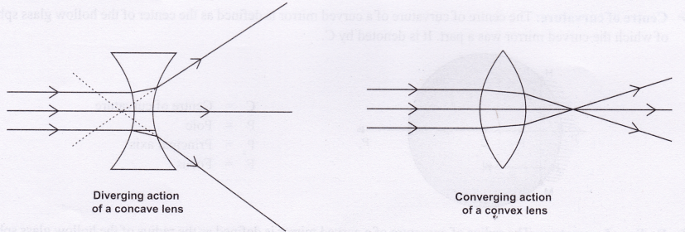
Spherical Lens
Notes:
A lens is defined as a transparent optical material bound by two surfaces, of which one or both surfaces are spherical.There are two types of lenses:
Convex lens A lens which is thinner at the edges and thicker at the center is known as Bi-convex lens.
Concave Lens A lens bounded by two spherical surfaces, curved inwards is known as bi- concave lens (or simply concave lens) It is also known as diverging lens because it diverges the light.

Slide 7
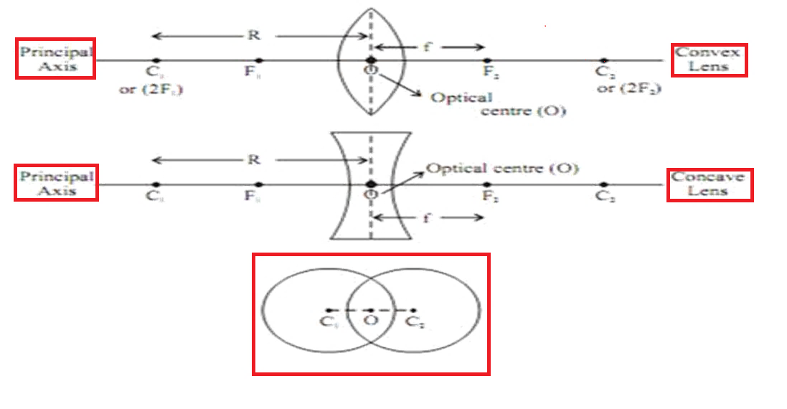
Basic Terms Related to Spherical Lens
Notes:
The following are he terms associate with the lens. Refer to the diagram.
Centre of curvature : Center of an imaginary sphere of which the curved surface of the lens is a part of .(C and C’)
Principal axis :Imaginary straight line passing through the two centers of curvature
Optical Centre :Point in a thin lens where a ray passing through it goes undeviated.(O)
Aperture : The effective diameter of the circular outline of a spherical lens.
Focus of lens : Beam of light parallel to principal axis, after refraction converges to a point or appears to diverge from a point is called the focus of the lens.(refer to diagram in the next slide).
Twice the focal length is equal to the center of curvature.

Slide 8
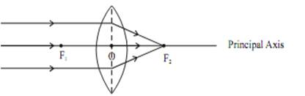
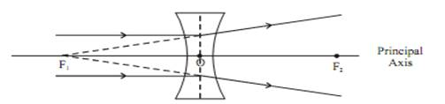
Convex lens and concave lens
Notes:
For a convex lens ,Rays parallel to the principle axis after refraction through the lens meet at a point which is called the focus of the lens.
In a concave lens, rays rendered parallel to the lens after refraction appear to diverge from a point. This point is referred to as the focus of a concave lens.
The distance between the focus and the optic center of the lens is called focal length(OF1 and OF2). It is denoted by ‘f’ .

Slide 9
Ray diagram Rules
Notes:
In order to geometrically construct images for lenses,the following rules are to be followed.
Rule 1:A ray passing through optic center O passes without any deviation.
Rule 2:After refraction, a ray parallel to principal axis will always pass through focus (F).
Rule 3: A ray passes through F, after refraction will emerge parallel to principal axis

Slide 10
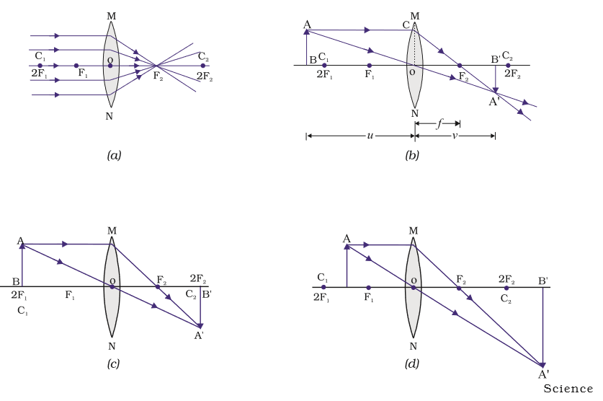
Image formation by a convex lens
Notes:
To draw ray diagrams and for obtaining the position of the image,use any two of the above stated rules.
Let us look into the Geometrical construction of images in a convex lens
When object is at infinity and rays are parallel to the principle axis the image is formed at the focus on the other side of the lens. The image formed is real ,inverted and highly diminished.It is used as a burning glass. See image (a)
When the object is beyond the center of curvature or between infinity and center of curvature: The image is formed between Focus and the center of curvature on the other side of the lens.The image formed is real, inverted and diminished. Take a look at image (b)
When the object is at the center of curvature, the image is formed at the center of the curvature on the other side of the lens. The image formed is real,inverted and of the same size as the object.Look at image ( c )
When the object is between the center of curvature and the focus. The image is formed between center of curvature and infinity on the other side of the lens.The image formed is real, inverted and magnified. Image (d)

Slide 11
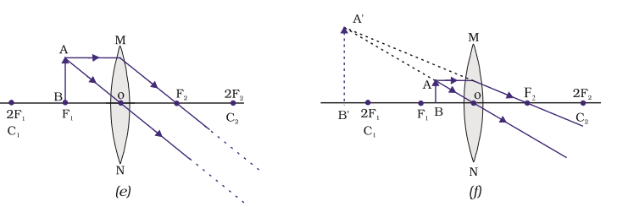
Image formed by convex lens
Notes:
When object is at the focus,the image is formed at infinity on the ther side of the lens. lThe image formed is real,inverted and highly magnified.(image e)
When the object is between the focus and the optic center, the image is formed on the SAME side of the lens. The image formed is virstual,upright and magnified.(image f)
We have now seen all the six possible positions of the object and its corresponding image formation.

Slide 12
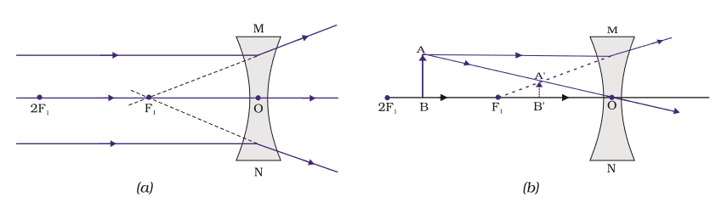
Image Formation by Concave Lens
Notes:
Geometric construction of images in a concave lens include:
When an object is at infinity, the image is formed at the focus on the same side of the lens. The image is virtual ,upright and diminished to a point.
When the object is ANYWHERE between the optical center(O) and infinity, the image is formed between the focus and the optic center on the same side of the lens and the object. The image is diminished , upright and virtual

Slide 13
Sign Convention for Refraction by Spherical Lens
Similar to that of spherical mirror, only the difference is that all the measurements are made from optical center ‘O’.
Notes:
For refraction ,the following are the sign conventions :
All distances are measured from the optical center of the lens.
The distance measured from the optical center in the direction of the incident light are taken as positive.
The distance measured from the optical center, opposite the direction of incident light are taken as negative.
The distance measured upward and perpendicular to the principle axis are taken as positive.
The distances measured downwards and perpendicular to the principle axis are taken as negative.

Slide 14

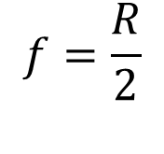
LENS FORMULAE
f - distance between focus and ‘O’
u –distance of object from ‘O’
v –distance of image from ‘O’
R –distance between center of curvature and ‘O’
$$\frac{1}{f}=\frac{1}{v}−\frac{1}{u}$$
$$f=\frac{R}{2}$$
Notes:
Using the above mentioned sign conventions, the lens formula is derived as 1/f= 1/v – 1/u .

Slide 15
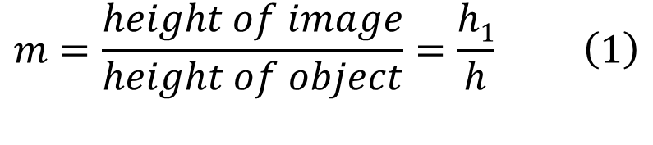

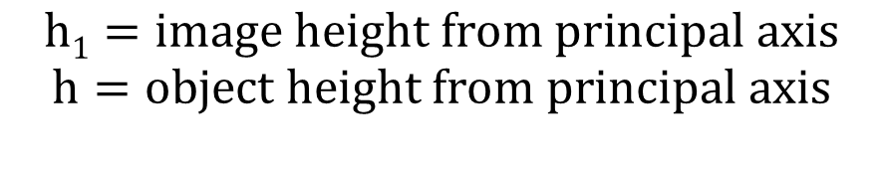
Magnification of lenses
It is defined as the ratio of the height of image to the height of object.
It is also related to ‘u’ & ‘v’
$$m=\frac{height of image}{height of object}=\frac{h1}{h} \left(1\right)$$
$$h1=image height from principal axis$$
$$h=object height from principal axis$$
$$m=\frac{v}{u} \left(2\right)$$
Notes:
Linear magnification is defined as the ratio of the size of the image to the size of the object or the ratio of image distance by the object distance.
From equation (1) & (2) If magnification m > 1,then image is magnified m = 1 ,image is of same size m < 1, image is diminished

Slide 16
Remember Sign Convention for Spherical Lens
 | F | U | V
Concave | -ve | -ve | -ve(Virtual image always)
Convex | +ve | +ve | +ve(Real) -ve(Virtual)
h of object is always positive
h of image is –ve if real and +ve if virtual

Slide 17

Power of Lens
$P=\frac{1}{f}$ (where f is in meters)
$P=\frac{100}{f}$
Notes:
Power of the lens is defined as the measure of deviation of the rays passing through the lens.
The reciprocal of the focal length in meters is called the power of the lens.
The power of the lens is measured in Dioptre.(D)
The power of the convex lens is taken as positive and that of a concave lens is negative.
If two lenses of powers p1 and p2 are placed in contact with each other,then their combined power P=p1+p2.

